Slide 1


The Project name
FACULTY OF COMPUTER
AND INFORMATION SCIENCE
Mobile web site
ASSIUT UNIVERSITY
Group members:
1- Ahmed Mohamed Gamal El_Deen.
2- Ahmed khalaf Ahmed Abdel Rahem.
3- Abdelrady Elagamy Abdelrady.
4- Mostafa Hassan Mohamed.
5- Tarek Mohamed Mohamed.
May-07

Slide 2
Supervised By:
Dr. Taysir Hassan Abdel Hamid
Information System
Third year

Slide 3
The objectives of our project :-
Search about specific type of phones.
Search about specific company products.
View Phones details.
Sell Phones to customers.
Modify Phones details (for administrator).
Add new Phones (for administrator).
Make orders.
Validate credit card.
Download phone’s software and tones.

Slide 4
Expected values
Tangible:
  Increase phone sales.
  Reduce cost.
  Reduce customer time.
Intangible:
  Improve customer satisfaction.
  The company will be known.
  The departments of company will easily communicate.
  Reduce possibility of error occurrence.

Slide 5
Constraints
Project must be delivered within two months.
Moderate budget for our system.
The system must provide high security.
program shouldn't cause any economic or physical damage in the event of system failure

Slide 6
Feasibility Analysis
Technical Feasibility (moderate):
  Familiarity with Application (moderate):
    Users have some experience with web application knowledge.
    The information system department has very good experience with application area.
  Familiarity with technology (moderate):
    Development tools & product of management application are available in market place & we have a good experience with them
    We are aware of ASP.Net, database management system (DBMS) & ADO.Net Technology due to using it before.
    The system will run off of robust & stable Server.
  Project size (moderate):
    We estimate that the project is moderate in size.
    With some effort, we can design the system to be reliable & to be more efficiency thanks to new technology we use.

Slide 7
Economic feasibility (excellent):
  Tangible cost & benefit:
    Increase phone sales.
    Reduce cost.
    Reduce customer time.
  Intangible cost & benefit:
    Improve customer satisfaction.
    The company will be known.
    The departments of company will easily communicate.
    Reduce possibility of error occurrence.

Slide 8
Organizational feasibility (excellent):
  Project champion:
      Dr/ Taysir Hassan Abdel Hamid.
  Senior Management:
    There is very strong of the project within the senior management team.
  Users:
    Users of web.
    Other companies associated with that domain.
  Other Stakeholder:
    System’s manager.
    System’s employees.

Slide 9
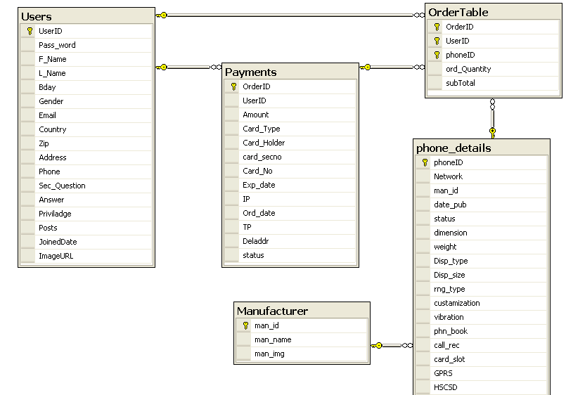
The ERD diagram of the project

Slide 10
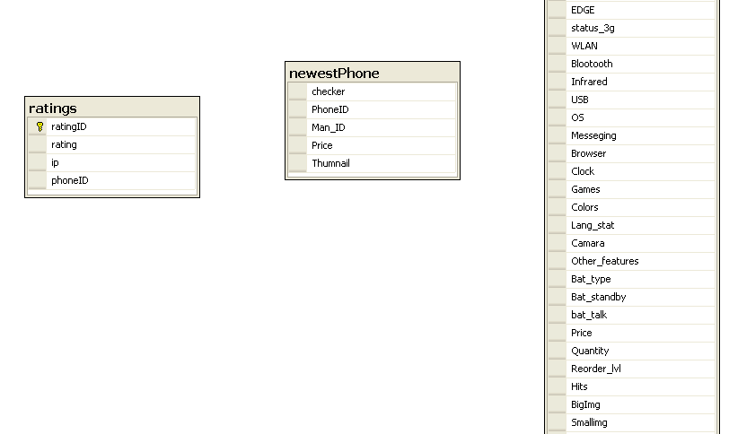
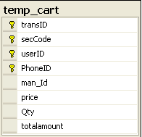

Slide 11
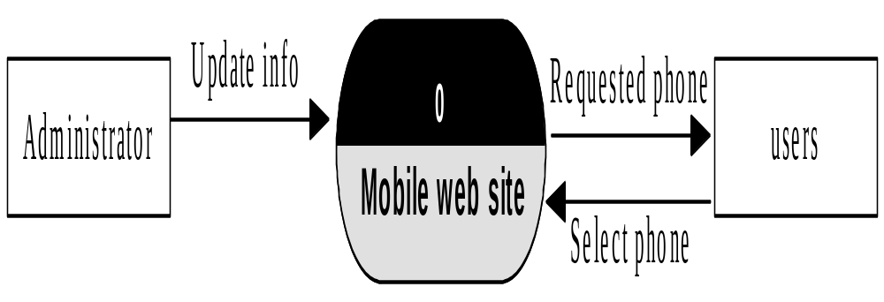
Data Flow Diagram (DFD)
Context diagram

Slide 12
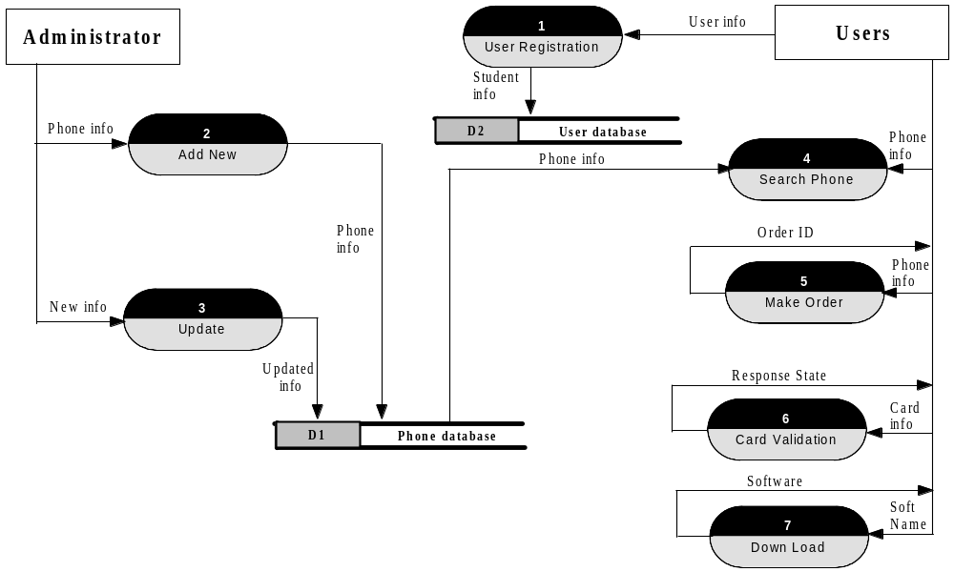
Data Flow Diagram (DFD)
Level (0) DFD.

Slide 13
The Implementation of the project
We will examine the steps that our project will follow it or We will examine the tasks of our project using figures.

Slide 14
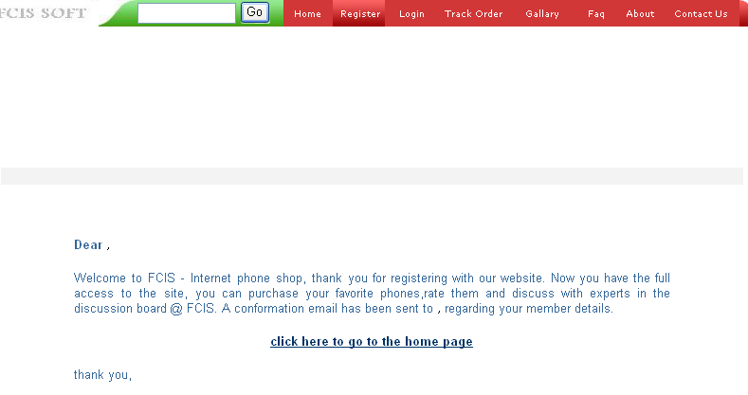
The first page (Home)

Slide 15
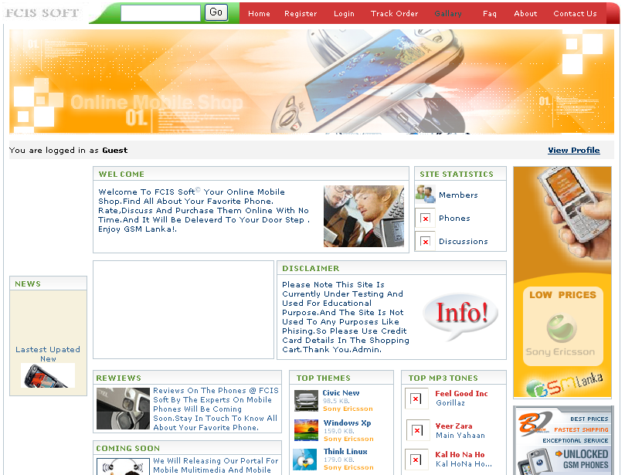



Slide 16
When the user or customer visit the site in the first time he must first write the registration information .
Here we show the registration page of the new user.

Slide 17
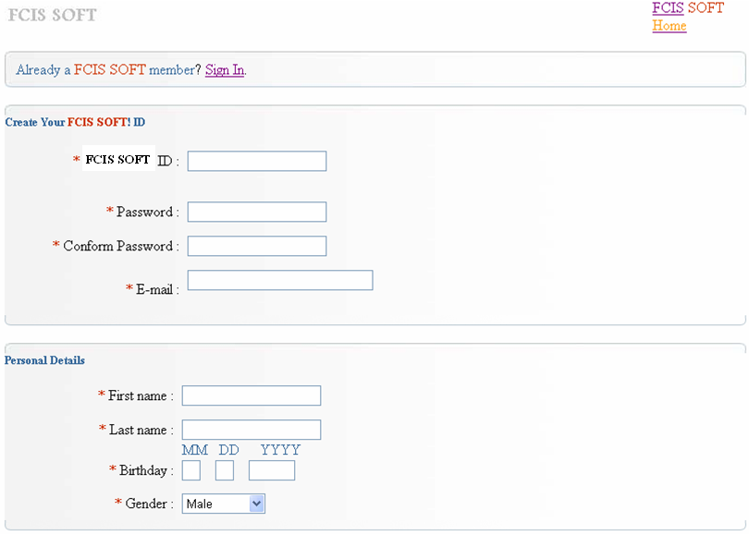
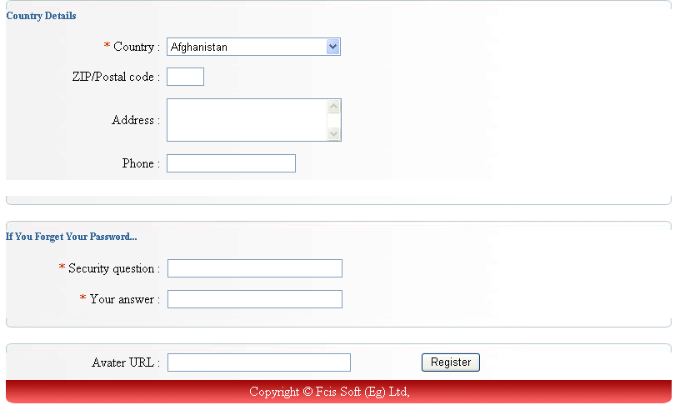

Slide 18
If the new user has entered the true registration information then a configuration message will appear to him that he has successfully has his own id in the site.
Here we show the configuration message will appear to the user or the customer.

Slide 19
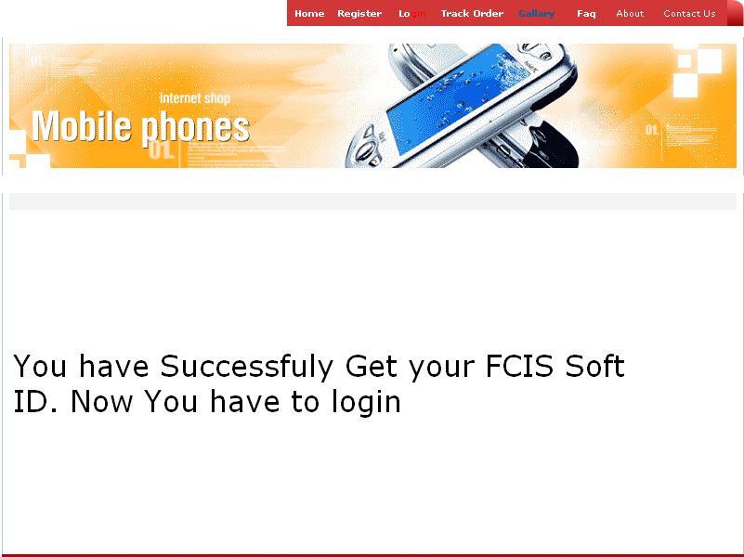

Slide 20
When the user or customer visit the site before he only go to the login and write his name and password .
Here we show the login page for the customer.

Slide 21
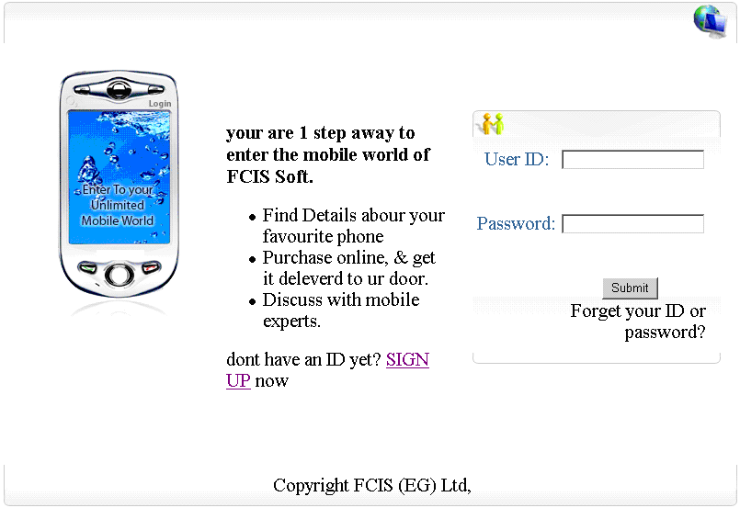
admin
*****

Slide 22
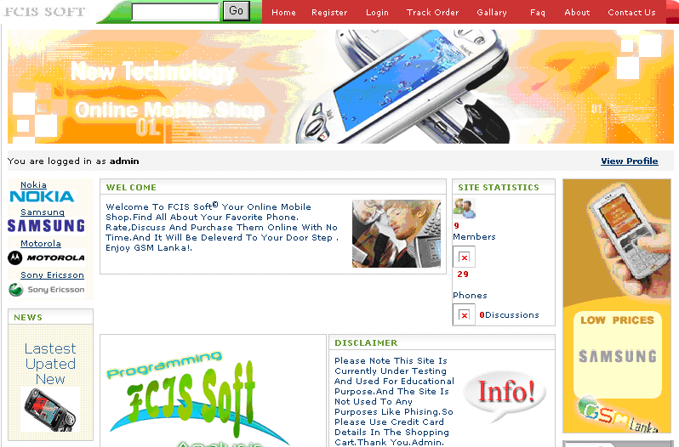



Slide 23
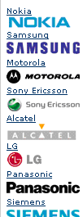
Then the user who logged on can choose from different types of phones from the left side menu has shown in the page
Here the figure that show the menu that the customer choose from.
If the user choose for example the type nokia then a list of all available nokia phones will be shown.

Slide 24
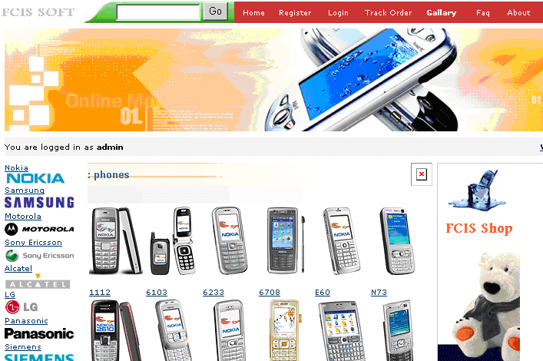

Slide 25
For example:-
when choose nokia phone type like N72 then a whole description of this type will be show to the customer or the user and if this type is what the customer or the user wanted then there is a button that allow the customer or the user to add this product to his cart.

Slide 26
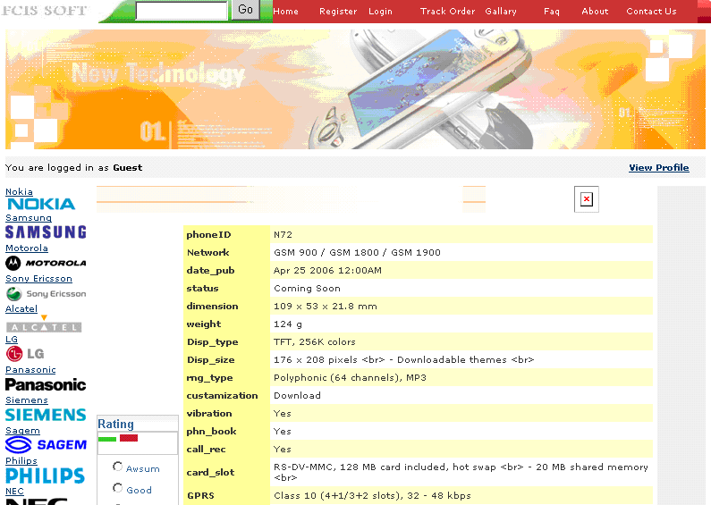

Slide 27
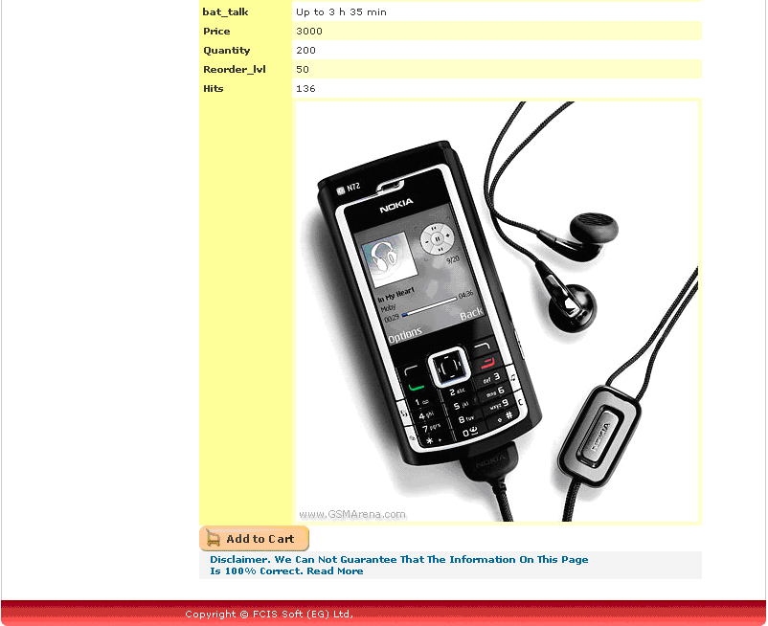

Slide 28
If the customer or user clicked the button add to cart then a new page will shown to him to add the quantity of that product.
Here we show this page.

Slide 29
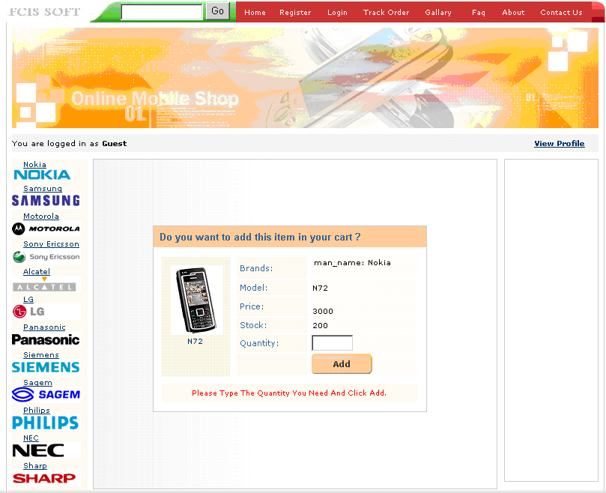

Slide 30
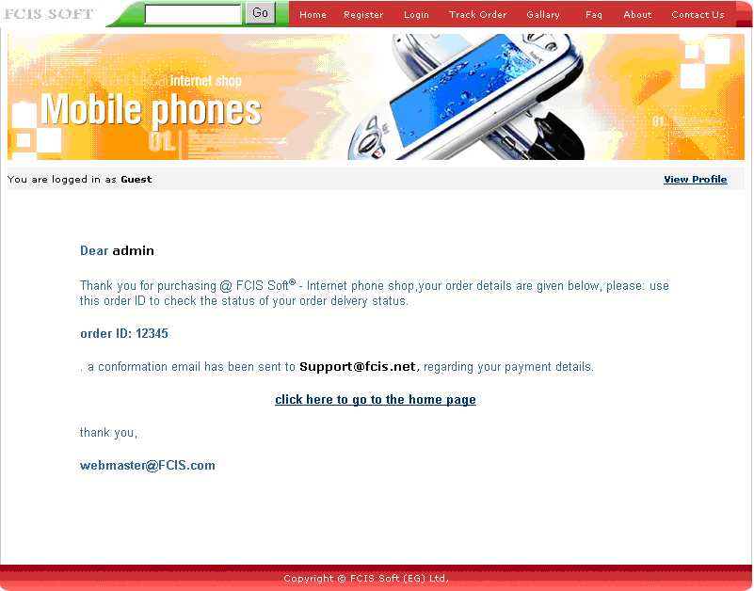

Slide 31
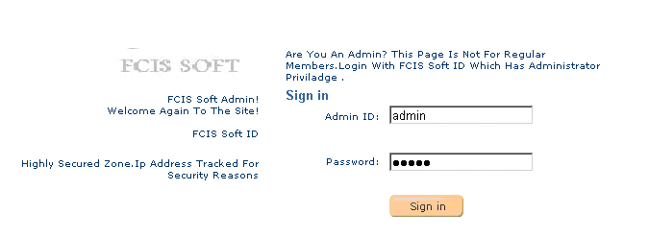
This is the page that the administrator only can login.

Slide 32
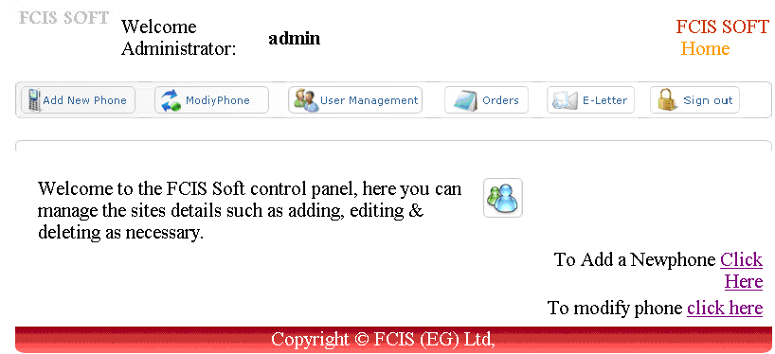
This is the home page that the administrator only.

Slide 33
There are some actions that the normal user can not perform only the administrator can perform it like modify the phones details ,add new phones and so on.
Here we show the page that the administrator can modify the phone add new phones through it.

Slide 34
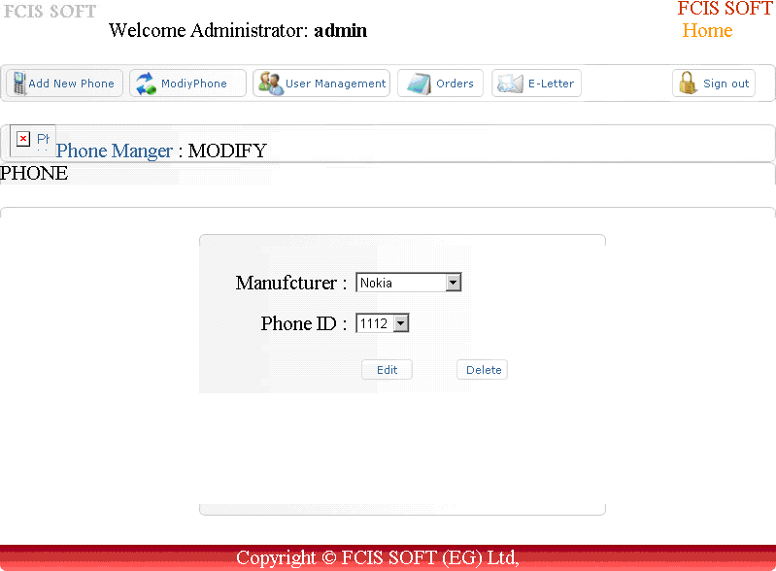

PHONE

Slide 35
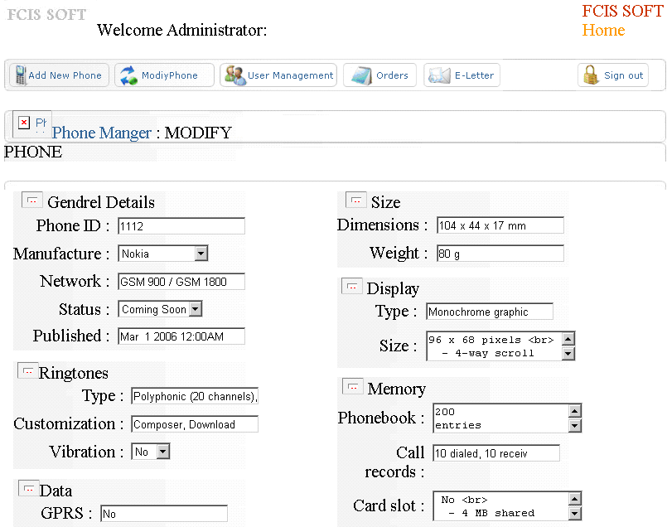
PHONE

Slide 36
The figure that show the add function of the administrator.

Slide 37
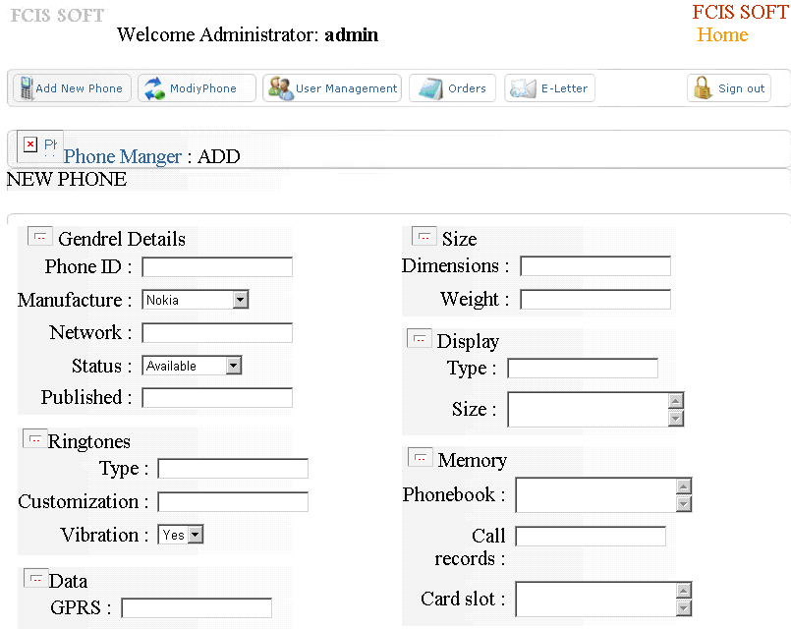
NEW PHONE

Slide 38
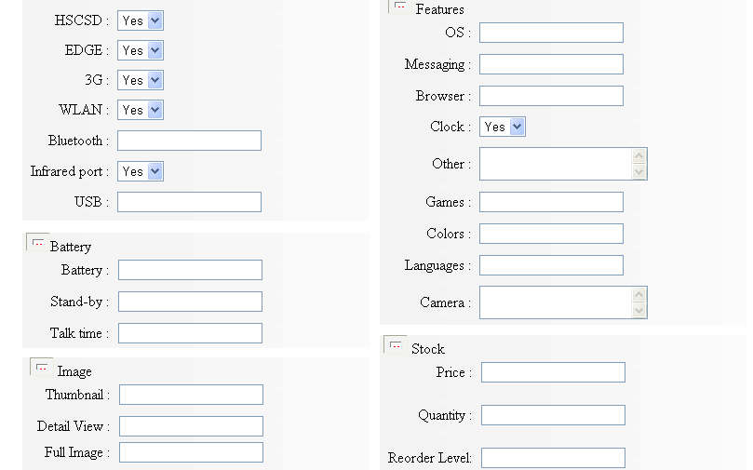

Slide 39
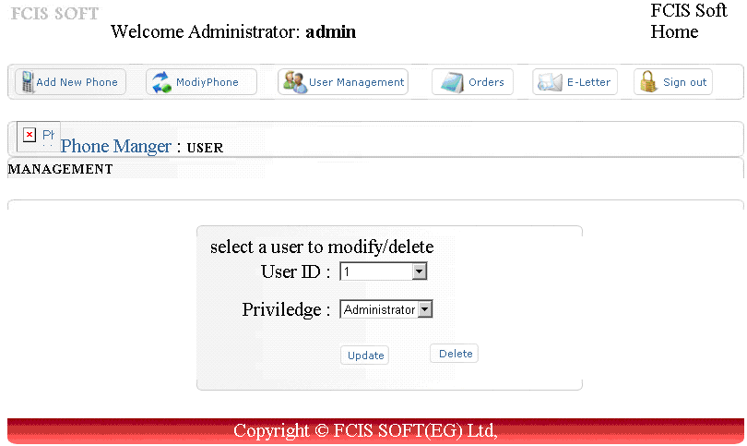
This is the page that the administrator can manage users from it.

Slide 40
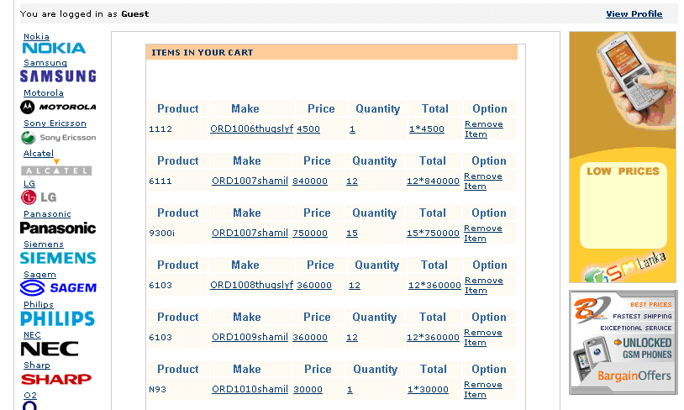
The page that show the items in user cart .

Slide 41
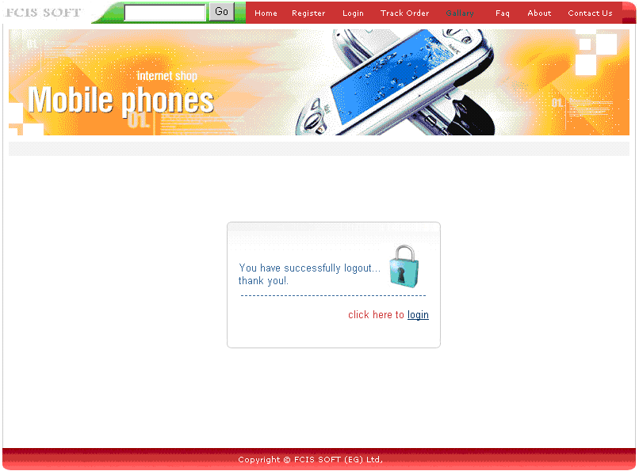
This is the page that is shown when the user logged out.

Slide 42
This is the links to our project documentations :-
Work Plan.
System Request.
Feasibility Analysis.
ERD diagram.
DFD diagram.
The Project.

Slide 43
By Engineer
Ahmed Gamal

